Slide 1
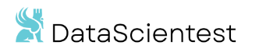

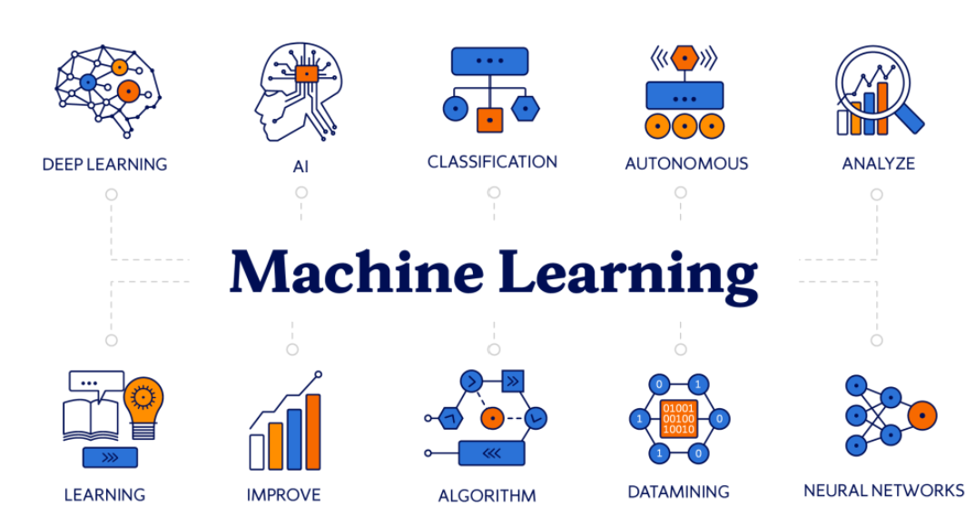
CryptoBot with Binance
OPA
OPA Bootcamp DE Feb 2025

Slide 2









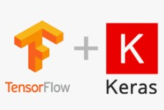




OPA CryptoBot with Binance
Content
Project scope
Architecture
Database structure
API
Data loader (Bionance)
Machine learning (LSTM)
Streamlit (Dashboard)
Improvements
OPA Bootcamp DE Feb 2025

Slide 3
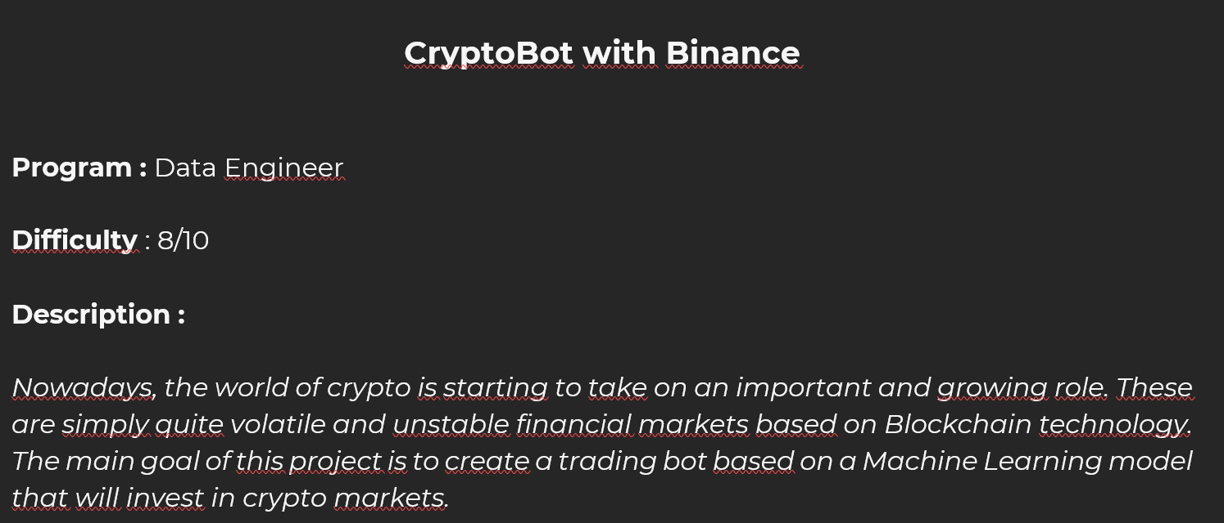
OPA CryptoBot with Binance
Project scope
Team
Three members (two decided to leave the project after some basic invovement)
Project name
OPA
OPA Bootcamp DE Feb 2025

Slide 4
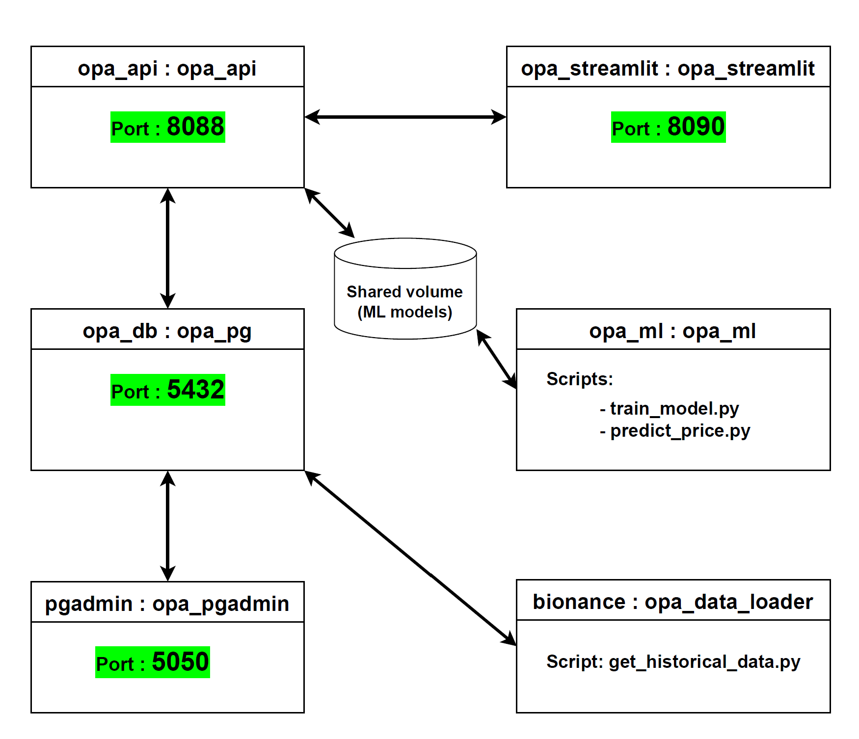
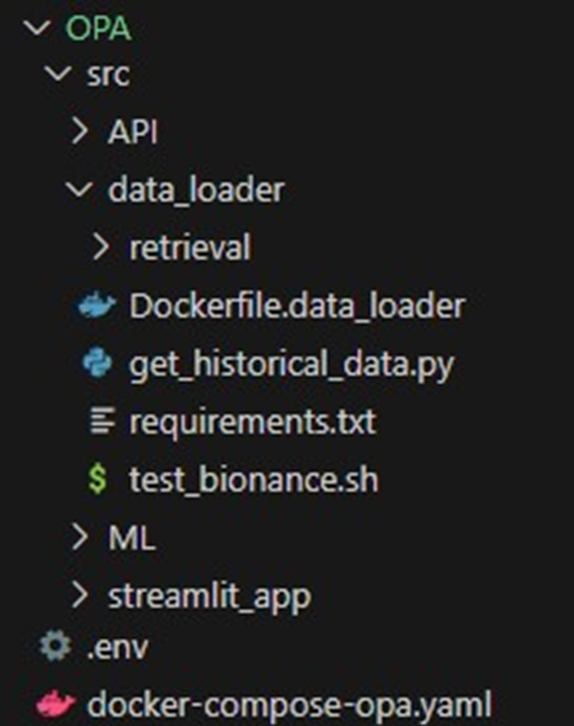
OPA CryptoBot with Binance
Architecture (Docker containers)
OPA Bootcamp DE Feb 2025

Slide 5
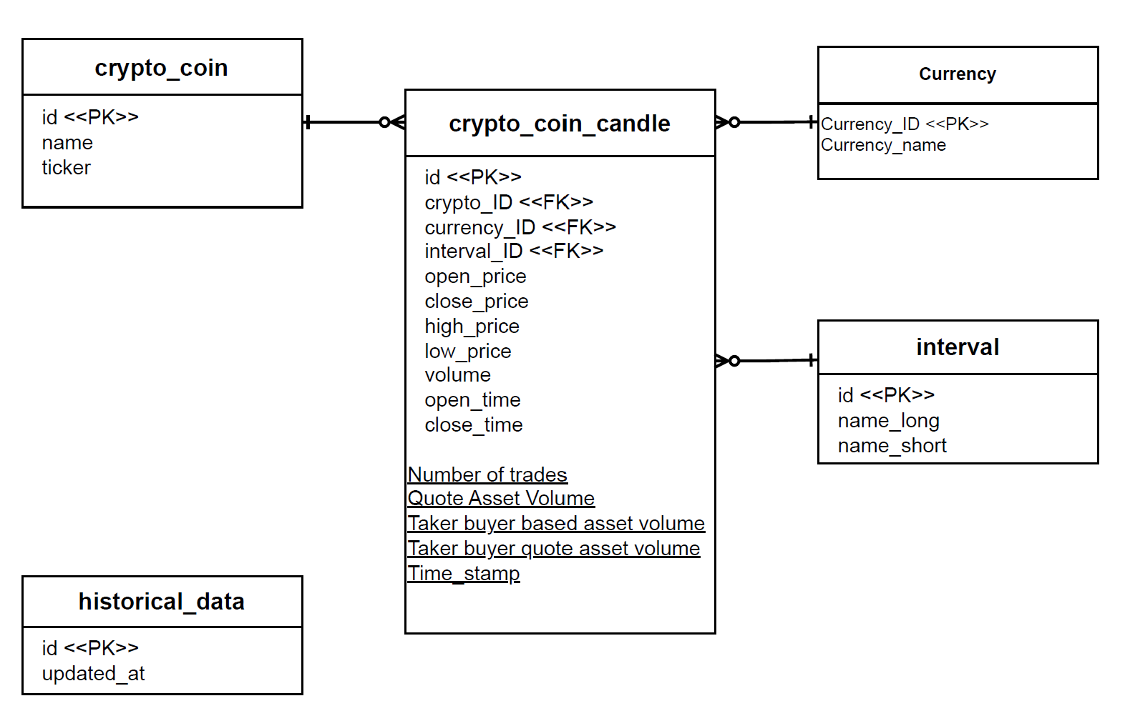
OPA CryptoBot with Binance
Database structure
Not implemented
OPA Bootcamp DE Feb 2025

Slide 6
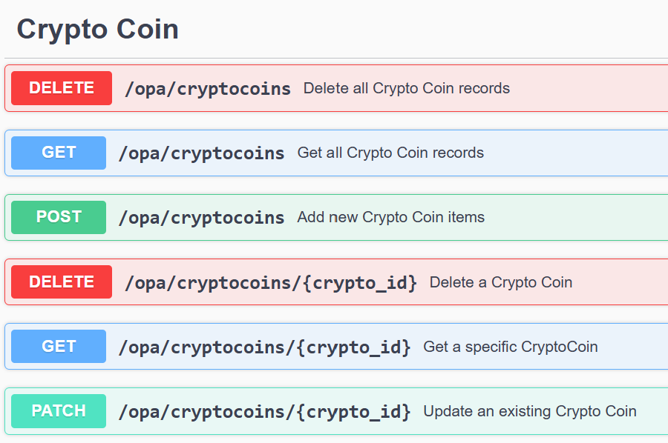
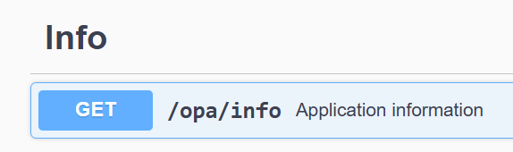
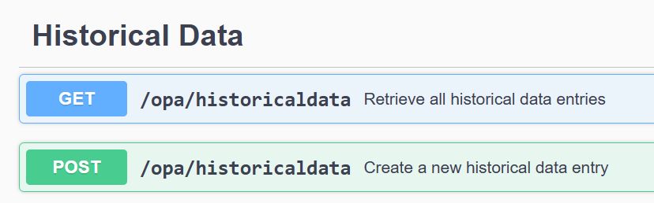
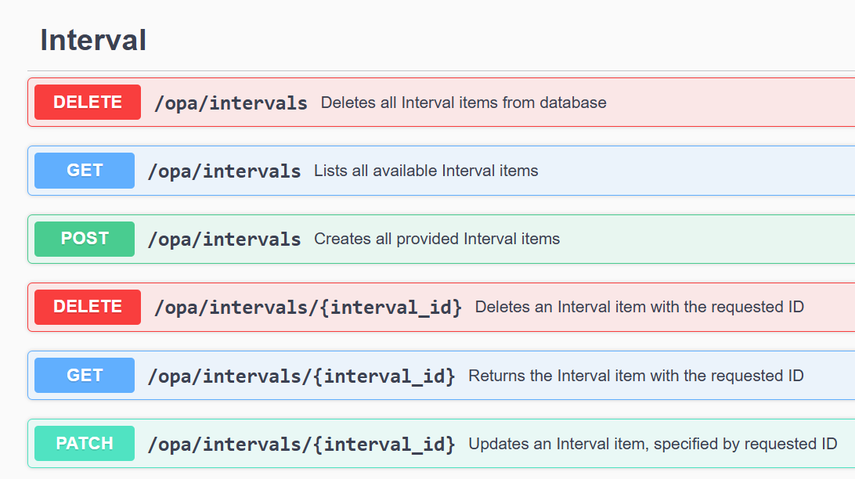
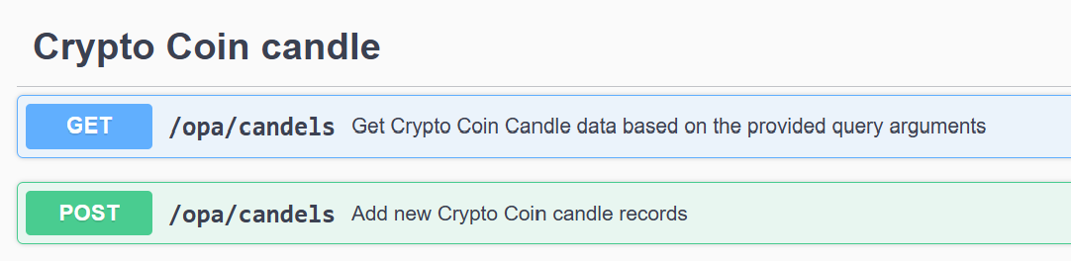
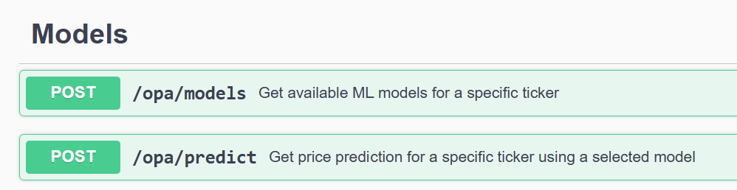
OPA CryptoBot with Binance
API
OPA Bootcamp DE Feb 2025
Not implemented

Slide 7
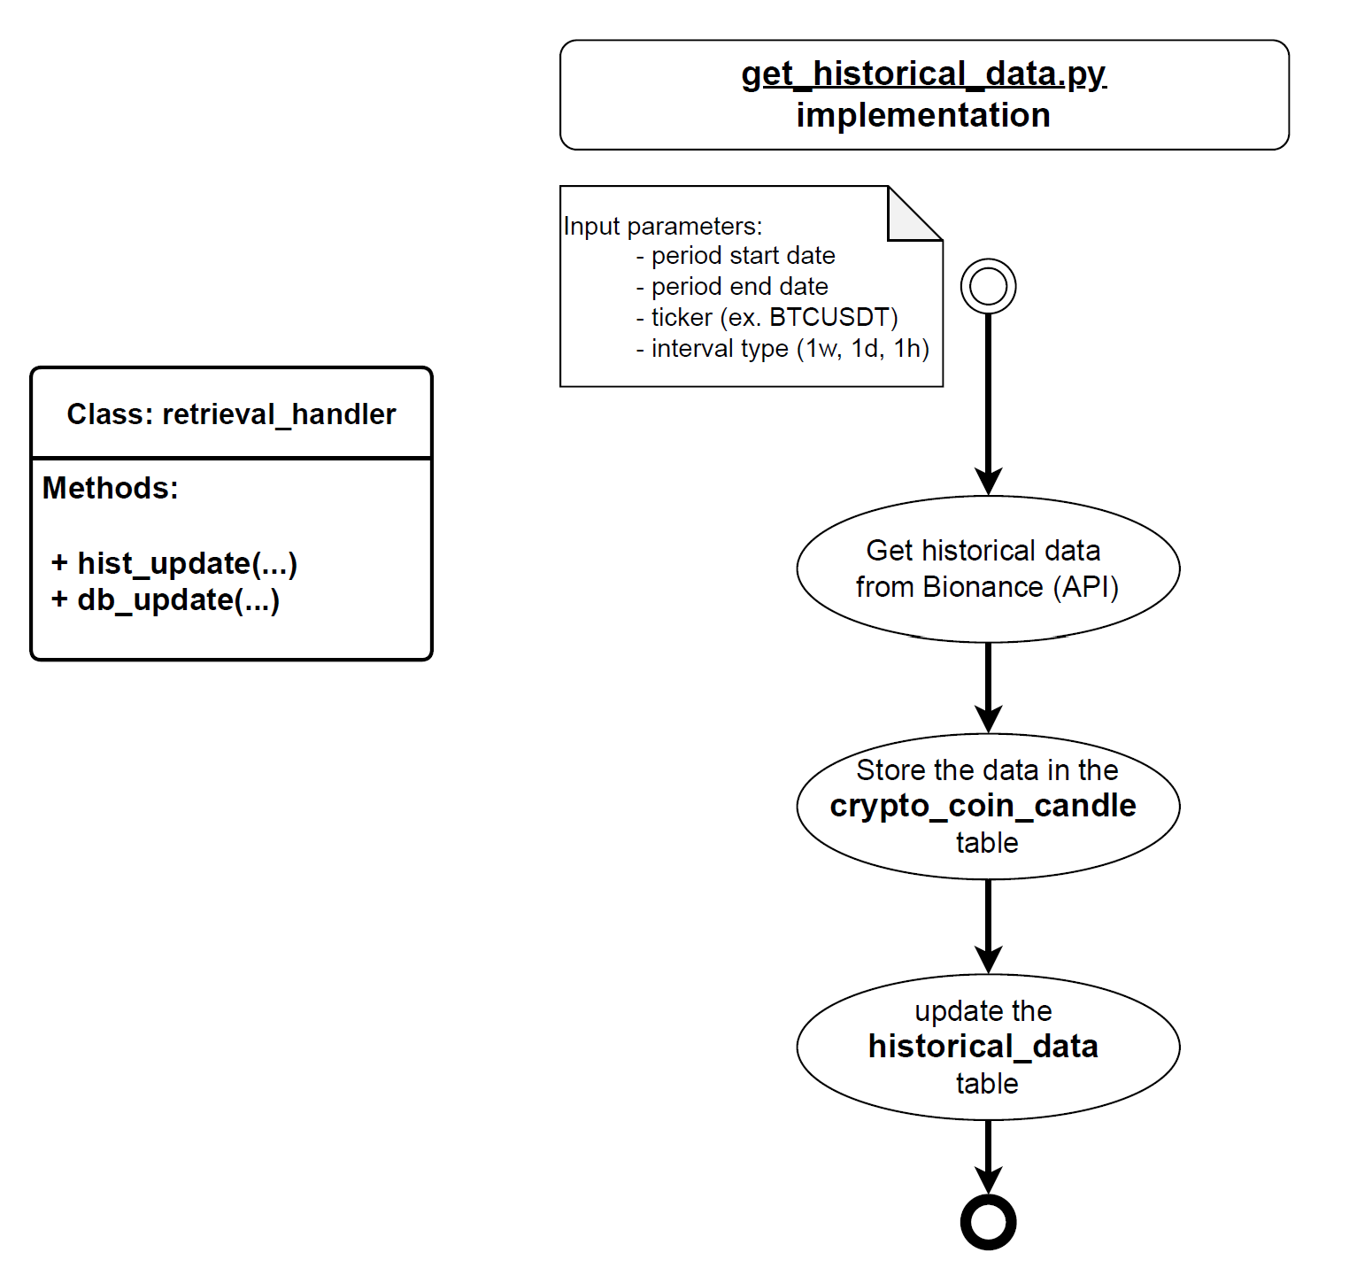
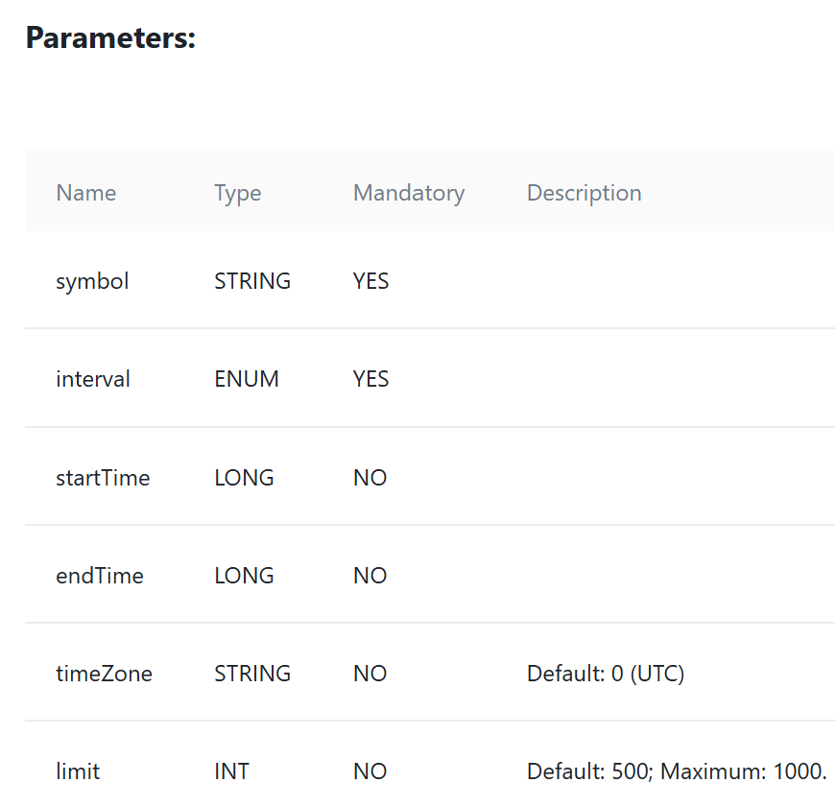
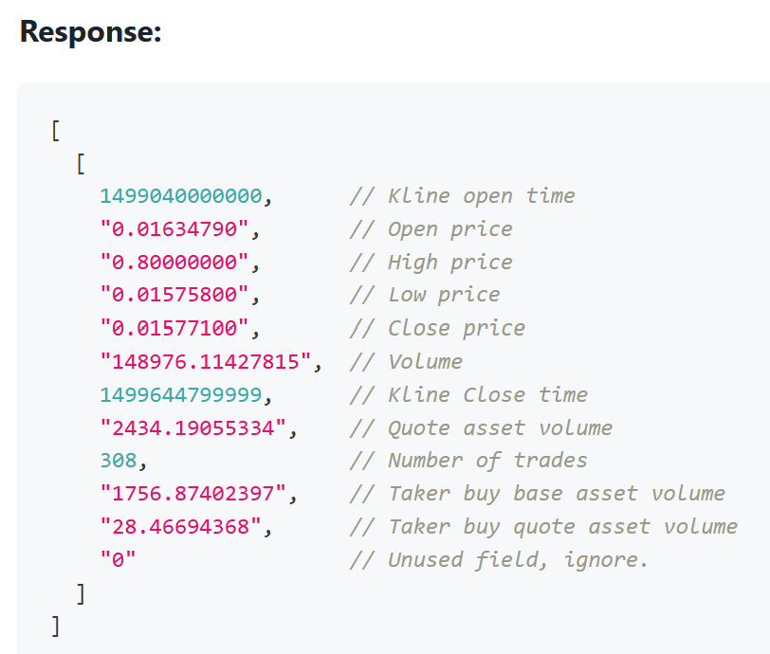
OPA CryptoBot with Binance
Data loader (Bionance)
Bionance endpoint used (https://api.binance.com)
GET api/v3/klines
Not implemented
OPA Bootcamp DE Feb 2025

Slide 8
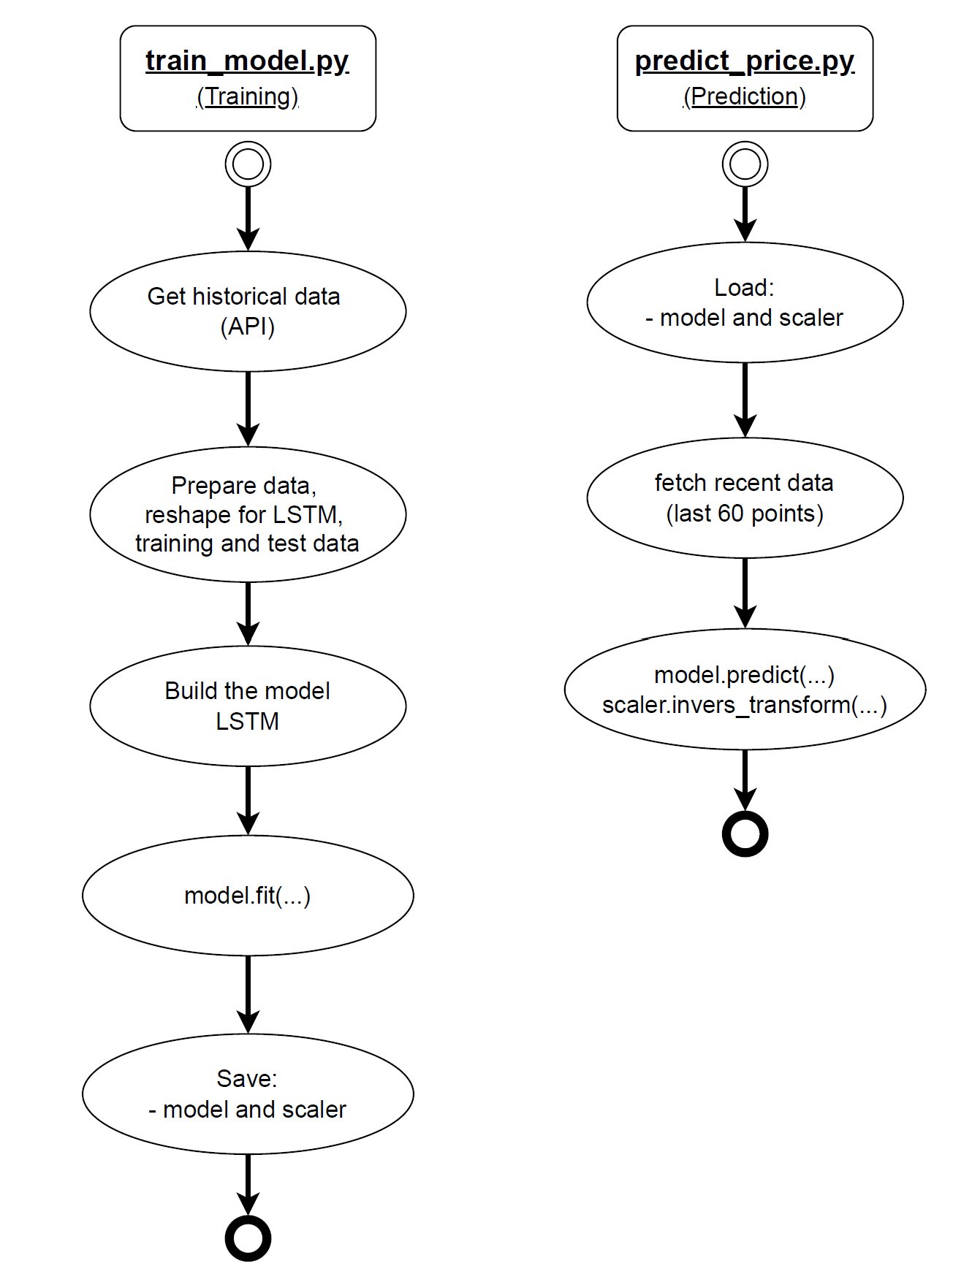
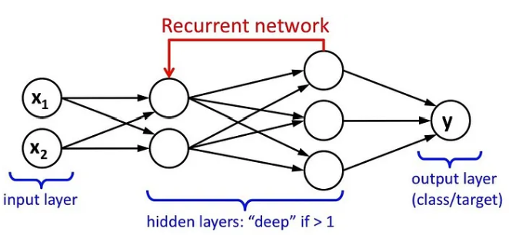
OPA CryptoBot with Binance
Machine learning (LSTM)
Parameters for training:
- optimizer = adam
- loss function = mean_squered_error
- scaler = MinMax (0,1)
Parameters for prediction :
- crypto coin ticker
- interval 1h, 1d, 1w
- pre-trained model + scaler
- last 60 data points (for prediction)
OPA Bootcamp DE Feb 2025
Notes:
What is Adam?
Adam stands for:
Adaptive Moment Estimation
It's an optimizer that combines the strengths of two other optimizers:
Momentum (which accelerates training),
RMSProp (which adapts learning rates).
⚙️ How Adam works (simplified):
At each training step, Adam:
Calculates gradient (how wrong the model is),
Maintains a moving average of past gradients (momentum),
Adapts the learning rate individually for each weight,
Updates weights in a way that converges fast and avoids oscillation.
✅ Why use Adam?
FeatureBenefitAdaptive learning rateWorks well with sparse or noisy gradientsRequires little tuningDefault settings often work wellFast convergenceEspecially helpful in deep networksCombines Momentum + RMSPropMore robust training

Slide 9
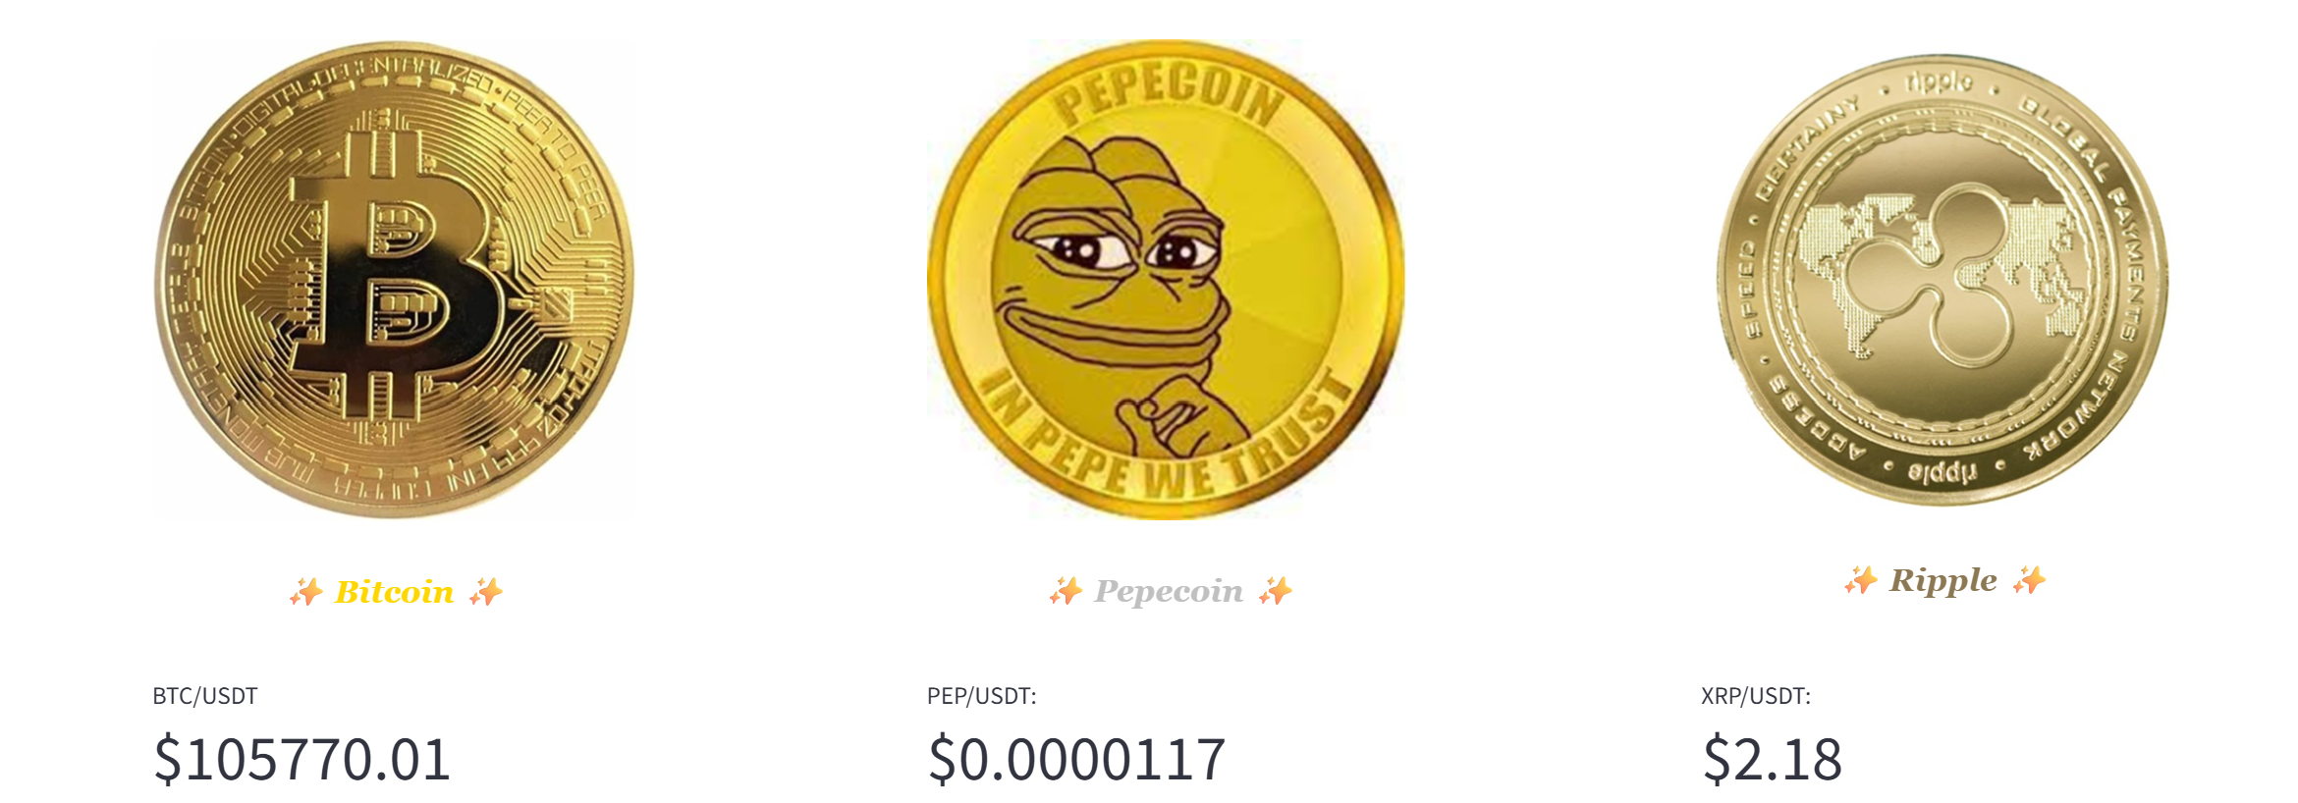
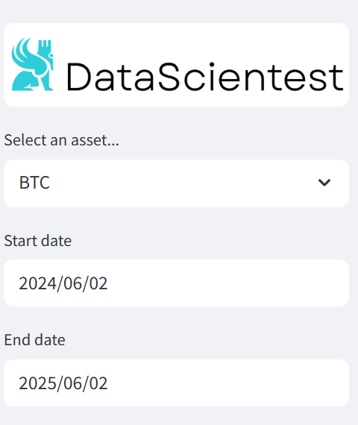
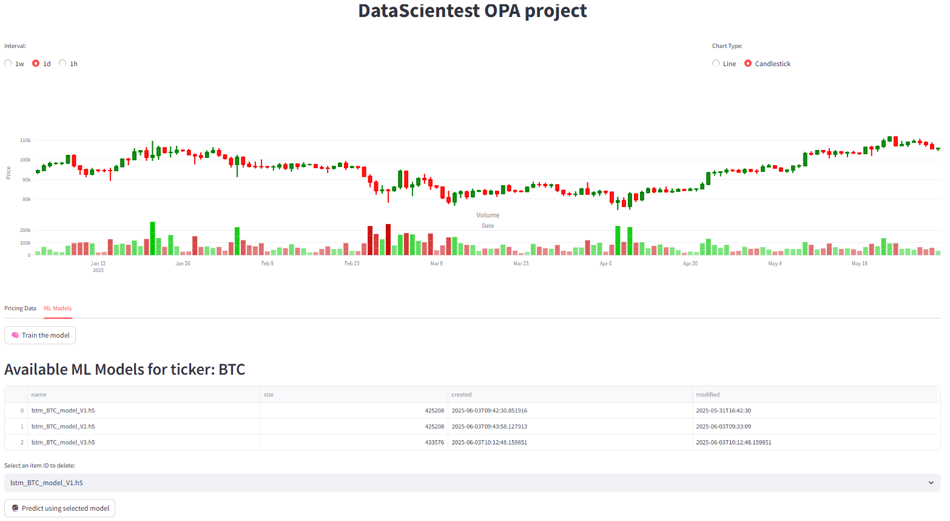
OPA CryptoBot with Binance
User interface (Streamlit dashboard)
OPA Bootcamp DE Feb 2025

Slide 10
OPA CryptoBot with Binance
Improvements
API : athentication + authorization + performance
Database : users management, cascading deletion
Streamlit : improve user interface
Logging : adding better logging to API, Streamlit and data loader
Data loader automation: use cron jobs (live ticker)
GitHub actions : code review, pytest
AirFlow Automation : test + deployment + training
Monitoring
Streaming with Kafka
OPA Bootcamp DE Feb 2025

Slide 11

OPA CryptoBot with Binance
Thank you
OPA Bootcamp DE Feb 2025

